Slide 1
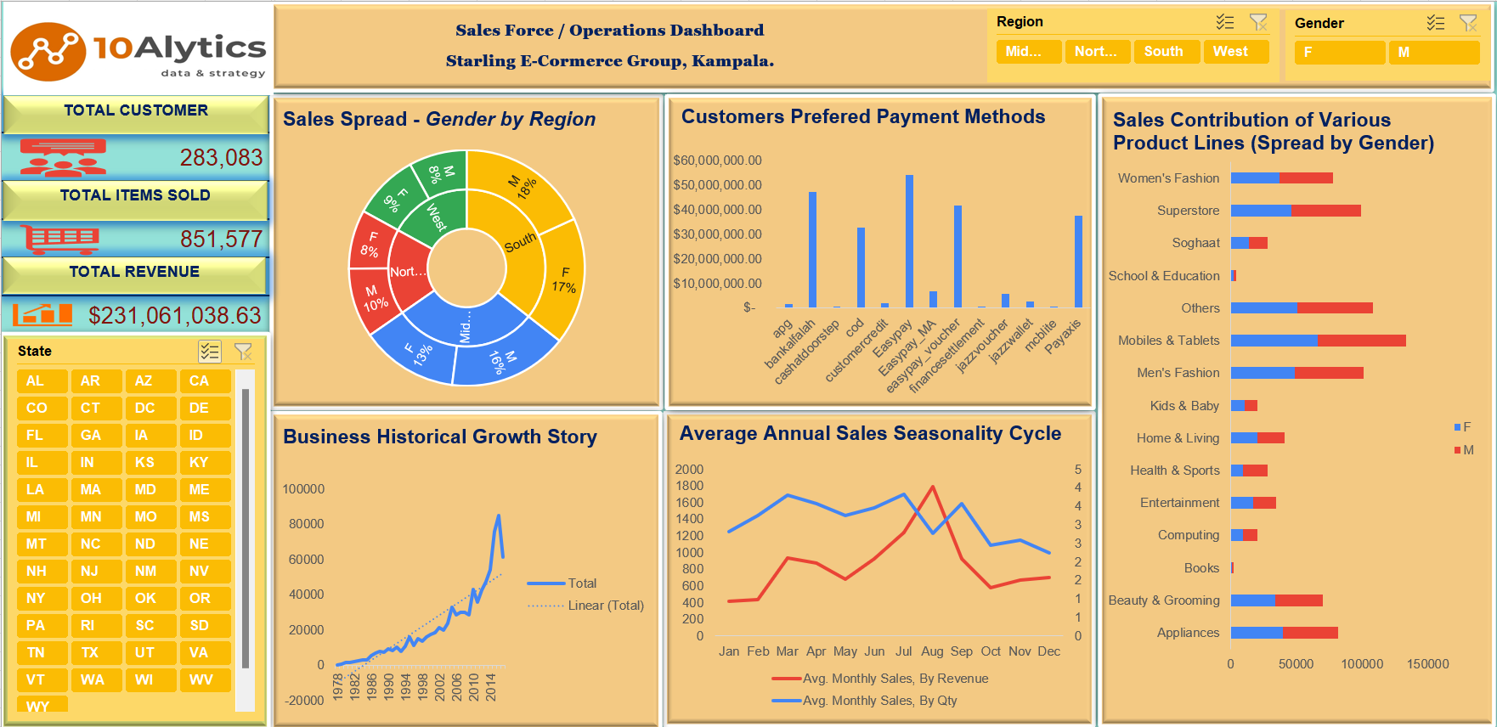
STARLING E-COMMERCE BUSINESS REVIEW

Slide 2
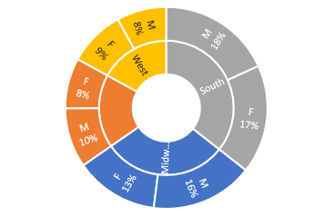
ANALYSIS 1: Analyze the demographics of the business spread.
RESULT:
CONCLUSION: The business has an even spread across the various regions and among the various genders.
Sales Spread - By Gender & By Region

Slide 3
ANALYSIS 2: Analyze business growth since inception
RESULT:
CONCLUSION: The company has, on average, doubled its sales revenue over two decades. A comparison with comparable businesses will indicate how good this growth is. The growth appears sustainable.
Business Historical Growth Story (Sales)

Slide 4
ANALYSIS 3: Analyze the Viability RESULT:
of Various products.
CONCLUSION:
Strength: Mobiles & Tablet, Men’s Fashion and
Superstore.
Opportunities: Women’s Fashion, Beauty &
Gaming and Appliances
Weakness: Soghaat, Home & Living, Health &
Sports, Kids & Baby and Computing.
Threat: Books, School & Education.
Sales Contribution of Various Product Lines (Spread by Gender)

Slide 5
ANALYSIS: Review seasonality trends of sales and advise optimal stock levels.
RESULT:
CONCLUSION: First half of the year is the peak sales period with a fairly even volume of sales. However, Q3 is the peak of sales for high-priced items.
Average Annual Sales Seasonality Cycle

Slide 6
ANALYSIS: Review of payment option preferences by customer
RESULT:
CONCLUSION: It may be recommendable for the company to consolidate payment options Payaxis, Easypay_Vaoucher, Easypay, Cod and BankAlfalah in line with customer preferences.
Customers Preferred Payment Methods

